Slide 1
Lecture 5
Energy Consumption and Production, Local Pollution, and Human Well-Being
Michael Greenstone
Milton Friedman Professor in Economics and the College
University of Chicago
Director Energy Policy Institute at the University of Chicago

Slide 2
Main takeaways
Many forms of energy consumption and production involve the release of pollution that is harmful to human well-being.
Air pollution due to energy consumption has been a major source of concern since the 12th century AD and remains an especially great risk to human well-being in today’s developing countries.
Economists have developed a variety of theoretical and empirical methods to determine people’s willingness to pay for environmental quality. The application of these methods suggest that people around the world are willing to devote substantial resources for environmental quality.
US has a long track record of success at reducing pollution. Overall, it appears that benefits have been larger than costs, possibly substantially so.

Slide 3
Introduction to local pollution
Local Pollution Sources
Local Pollution Types
Local Pollution Propagation
Why does air pollution matter?
Willingness to Pay for Environmental Quality
Pollution & Policymaking

Slide 4
Life-Cycle Pollution from Electricity Production
Emissions of local pollutants vary widely by the type of power source. The table below provides the ranges of life-cycle pollutant values, by source.
All of the listed pollutants except CO₂ have direct health impacts. Coal-fired power plants emit far more pollutants per unit of electricity compared to natural gas. Emissions from nuclear and renewable sources are negligible but nonzero due to delivery and manufacturing/construction. (Turconi, Boldrin, Astrup 2013)
Fuel Source | SO₂ (kg/MWh) | NO_{x} (kg/MWh) | CO₂ (kg/MWh) | Mean PM_{2.5} (kg/MWh) | Mean Mercury (g/MWh)
Coal | 0.1 – 1.0 | 0.3 – 1.0 | 800 - 1200 | 0.19 | 0.016
Natural Gas Combined Cycle | 0.01 – 0.32 | 0.2 – 1.3 | 350 - 410 | 0.02 | 0
Nuclear | 0.00 – 0.04 | 0.01 – 0.04 | 3.1 - 35 | ~0 | 0
Wind | 0.02 – 0.04 | 0.02 – 0.06 | 5 - 35 | ~0 | 0
Notes:
Main source: http://www.uni-obuda.hu/users/grollerg/LCA/hazidolgozathoz/lca-electricity%20generation%20technologies.pdf
PM source: http://www3.cec.org/islandora/en/item/10236-north-american-power-plant-air-emissions-en.pdf
Mercury source: http://www.seas.columbia.edu/earth/wtert/sofos/Bolate%20thesis_mercury.pdf
Reference source with no direct statistics: https://www.ceres.org/sites/default/files/reports/2017-06/Benchmarking-Air-Emissions-2017%20%281%29.pdf

Slide 5
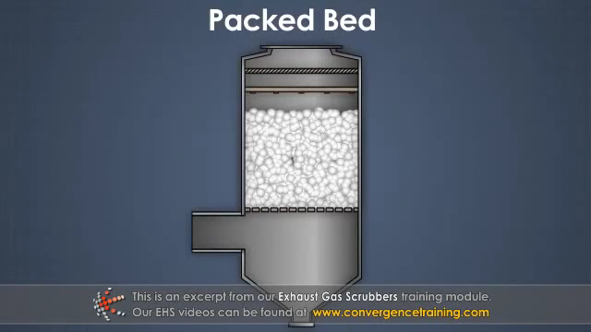
Mitigating Pollution in Electricity Production
Installing capital-intensive pollution-mitigating equipment is one way of reducing emissions
It is the most commonly prescribed choice by command-and-control regulations.
But there are often cheaper alternatives for emissions reduction, e.g. fuel-switching
Notes:
I don’t think it’s necessary to show this video, for the sake of time.
Video source: https://www.youtube.com/watch?v=kfyWD_7-42s

Slide 6
Pollution in Fuel Extraction
Coal
Coal sludge, an effluent from coal mining, is acidic (from dissolved sulfuric acid) and contains toxic heavy metals
Mining and coal transport release dust and soot particles, leads to endemic “black lung” disease among coal miners
Natural Gas
On-site diesel generators emit high levels of SO₂ and particulates.
Methane release, both in drilling and from pipelines, contributes 30% of lifecycle natural gas GHG emissions
Surface water pollution from improperly stored hydraulic fracturing fluids may cause negative health effects

Slide 7
Pollution in Transport
From last week:
Over 90% of the transportation sector’s energy comes from petroleum products, and GHG emissions from transport now exceed GHG emissions from electric power
Combustion of petroleum fuels, particularly diesel, also releases local pollutants
Over half of all CO and NO_{x} emissions in the US come from vehicular exhaust
Diesel exhaust is considered a Group 1 carcinogen, has much higher small particulate content PM_{0.1} than petrol exhaust
Notes:
A group 1 carcinogen has sufficient evidence of carcinogenity in humans

Slide 8
Introduction to local pollution
Local Pollution Sources
Local Pollution Types
Local Pollution Propagation
Why does air pollution matter?
Willingness to Pay for Environmental Quality
Pollution & Policymaking

Slide 9
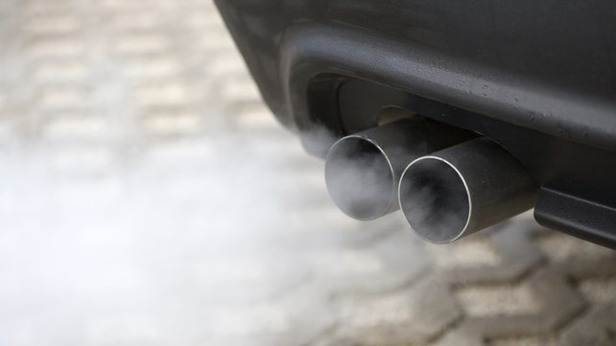
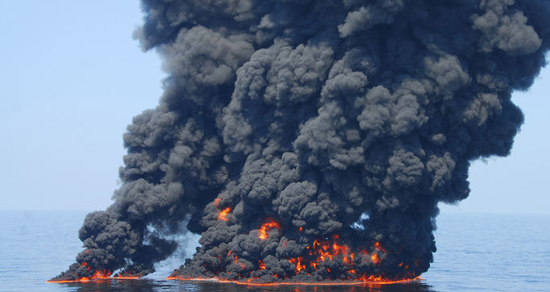
Primary types of local pollutants
1. Sulfur dioxide
2. Nitrogen oxides
3. VOCs and ground-level ozone
4. Particulate matter
Nitrogen oxides are part of car exhaust
Incomplete combustion is a major source of particulate matter
Notes:
In the following slides, we will discuss these pollutants one-by-one. We will see their sources, the science behind how they enter the air and how they affect humans and the environment. (VOC = volatile organic compounds)
The lower right picture is from the BP oil spill in the Gulf of Mexico. The black smoke is comprised of many pollutants, especially fine particulates of around 1 micrometer in diameter.

Slide 10
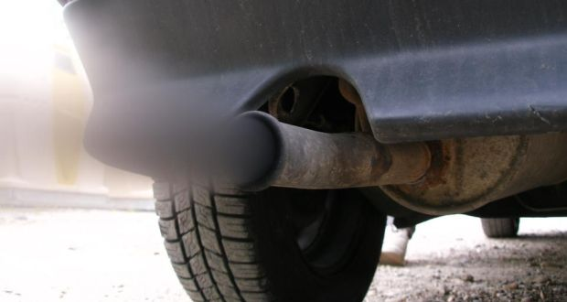
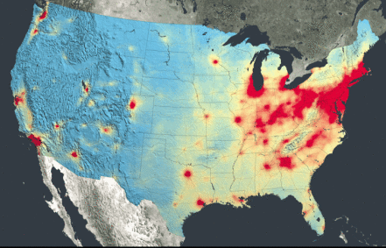
Sulfur Dioxide (SO₂) and Nitrogen Oxides (NO_{x})
The combustion of sulfur, e.g. in coal, produces SO₂
S + O₂ → SO₂
SO₂ and NO_{x} contribute to acid rain via sulfuric and nitric acids, respectively
NO_{x} are inputs to ozone production, associated with smog
Both can react with atmospheric compounds to produce haze and fine particulates
Reduces visibility and causes respiratory issues
US NO_{x} emissions

Slide 11
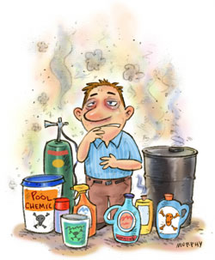
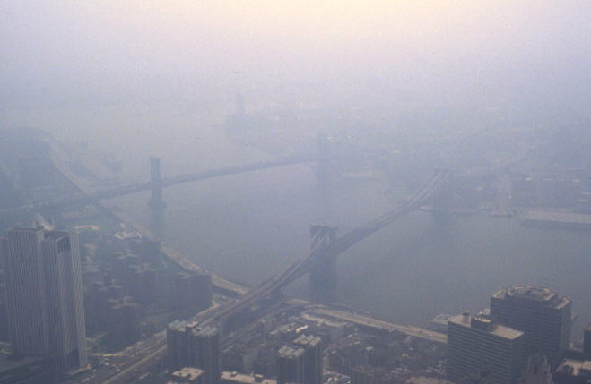
VOCs and Ground-Level Ozone
Volatile organic compounds (VOCs) include methane, formaldehyde, and many other vaporous chemicals
VOC and NO_{x} are perfect-complementary inputs in ozone formation, in the presence of direct sunlight
Ozone health effects:
Reduces lung function in short-term
Irritates & weakens the respiratory system
Increases long-term risks of bronchitis and lung disease
Ozone is the primary component of smog…
Many VOCs are identifiable from their odors
VOCs is the limiting reagent in ground-level ozone for NYC smog
Notes:
The production function of ozone looks like a Leontief L-shaped graph
While ground-level (tropospheric) ozone and stratospheric ozone are the same compound, ground-level ozone is bad for human health, while stratospheric ozone blocks out UV radiation, and is thus good for human health
In large cities like NYC, high levels of NOx emissions from cars and from nearby factories make it so that VOC is the limiting (relatively scarce) reagent in the production of ozone.
Source: EPA

Slide 12
Particulate Matter (PM)
Tiny airborne particles, e.g. mineral dust, smoke, ammonium nitrate, etc.
Many sources, including reactions of NO_{x} or SO₂ in the atmosphere
Classifications include PM₁₀ and PM_{2.5}
PM_{2.5} penetrates deep into the lungs with many negative health effects:
Decreased lung function
Respiratory problems, e.g. difficulty breathing, and respiratory diseases
Premature death and significantly reduced life expectancy
Notes:
PM10 refers to particles of diameter 10 micrometers, while PM2.5 refers to particles of diameter 2.5 micrometers. Both are far smaller than the diameter of human hair, which is around 60 micrometers.
Source: EPA and http://ac.els-cdn.com/S1352231004005011/1-s2.0-S1352231004005011-main.pdf?_tid=9bcd2df6-5e72-11e6-96a5-00000aab0f02&acdnat=1470775881_734d391bd2eae4c3f5c4bedaf0d2a3eb

Slide 13
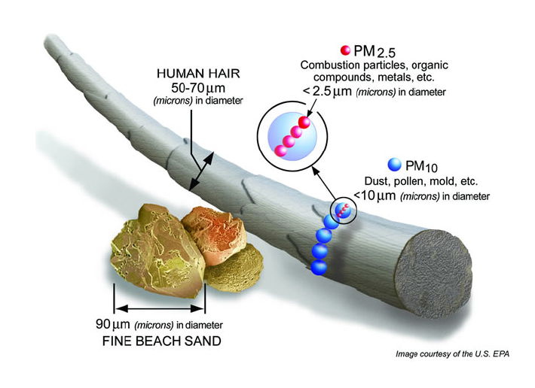
How small is PM?

Slide 14
Introduction to local pollution
Local Pollution Sources
Local Pollution Types
Local Pollution Propagation
Why does air pollution matter?
Willingness to Pay for Environmental Quality
Pollution & Policymaking

Slide 15
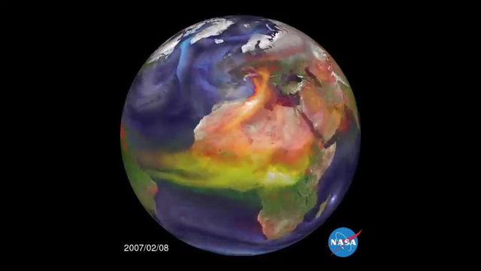
Pollution with local effects needs not stay local
This NASA animation demonstrates how various types of air pollution travel around the world. 1 second ~ 1 week of pollution.
Most of the pollution in the animation occurs naturally
Light blue = Sea salt
Green = Organic & black carbon
White: Sulfates
Red: Dust

Slide 16
Introduction to local pollution
Why does air pollution matter?
Air Pollution from Energy Use, Past and Present
Air Pollution and Human Well-Being
Willingness to Pay for Environmental Quality
Pollution & Policymaking

Slide 17
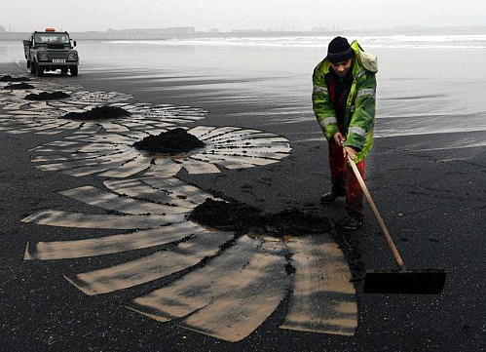
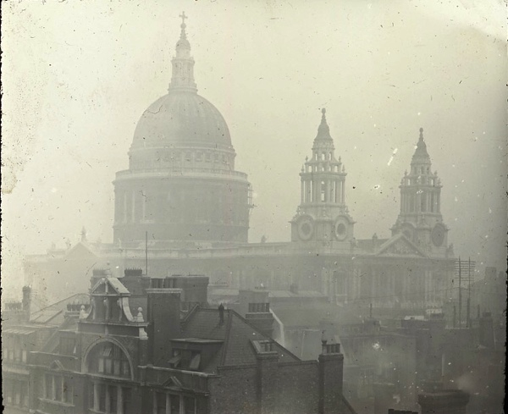
Air pollution from energy has long been a problem
England burned bituminous “sea-coal” starting in the 12thc AD
Inefficient burning led to frequent smog in London in Middle Ages
Around 1300, King Edward I banned sea coal. Violators were punished by death.
Shakespeare – “hover through the fog and filthy air” (Macbeth)
By the 19thc, coal mines in Northern England and Wales provided over 1 million Londoners with coal for heat
Led to infamous “pea-soupers,” e.g. at right

Slide 18
Severe pollution episodes in mid 20thc brought awareness to the perils of pollution
Great Smog of 1952
Due to a temperature inversion, a blanket of foul-smelling, yellow-brown fog smothered London for 4 days
Resulted in 12,000 deaths directly attributed to air pollution
Donora, PA (1948)
Home to US Steel plants, Donora experienced a temperature inversion that sickened half of the town’s population

Slide 19
Air Pollution in Los Angeles before 1970
Los Angeles was once one of the world’s most polluted cities
Combination of geography, sunlight, car exhaust, backyard incinerators, petroleum refineries, and factory emissions
Ozone levels in LA were routinely above 500 ppb in the 1960s
The current EPA ground-level ozone standard is 75 ppb
In 1955, downtown LA recorded an ozone level of 680 ppb, the highest ever recorded in the world
For comparison, ozone levels rarely rise above 250 ppb in Beijing
“You'd blow your nose, and it would be black”
The catalytic converter, higher fuel standards, and the Clean Air Act dramatically reduced LA’s pollution levels since 1970
Log Angeles haze, July 26, 1943. The smoke was so acrid and thick that some residents suspected a Japanese “gas attack,” but the cause was homegrown.
Notes:
Los Angeles: http://www.aqmd.gov/home/library/public-information/publications/50-years-of-progress
Beijing Ozone: http://aqicn.org/faq/2015-09-06/ozone-aqi-using-concentrations-in-milligrams-or-ppb/ and https://www.atmos-chem-phys.net/14/13175/2014/acp-14-13175-2014.pdf

Slide 20
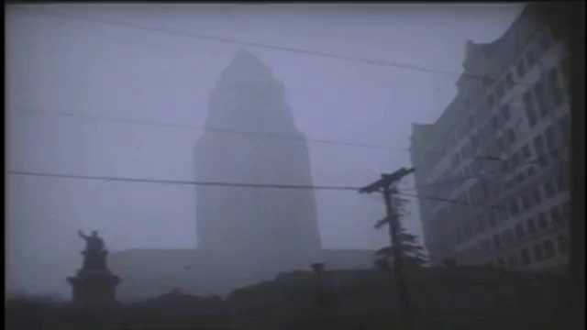
Illustration of Pollution’s Mid-20thc Effects
Three snippets from an air pollution documentary.
The first two snippets are from the mid-1950s. The last snippet is from 1979.

Slide 21
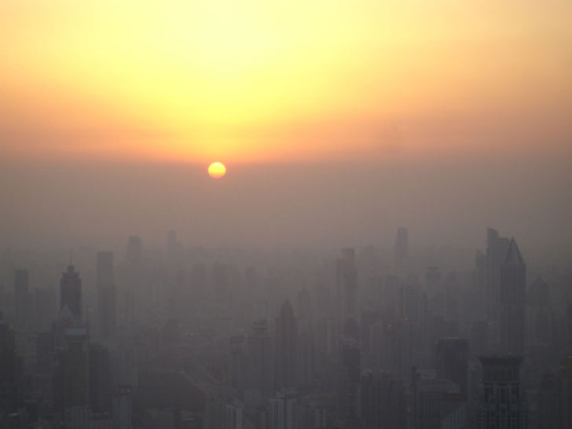
Air Pollution in China today
Ambient concentrations of total suspended particulates between 1981-2001 were five times the pre-Clean Air Act US levels
Burden falls particularly in northern regions, where a winter coal policy cut life expectancy by 3.1 years compared to southern China
Primary sources:
Coal: power plants, fuel boilers for heating, heavy industry (iron, steel, and cement factories)
Cars and trucks
Other factors:
Temperature inversions
Beijing sunrise
Notes:
Sources:
IEA World Energy Outlook special report on energy and air pollution 2016
http://green.blogs.nytimes.com/2013/02/14/the-air-that-kills-in-india/
Greenstone’s papers

Slide 22
Air Pollution in India today
11 of world’s 20 most polluted cities are in India
Poor enforcement of existing pollution regulations
The 15.5 million people living in Delhi would save nearly 9 years if Delhi’s incredibly high particulate pollution levels were brought to WHO standards
Over 70% households use solid fuels for cooking, leading to extensive indoor air pollution

Slide 23
Introduction to local pollution
Why does air pollution matter?
Air Pollution from Energy Use, Past and Present
Air Pollution and Human Well-Being
Willingness to Pay for Environmental Quality
Pollution & Policymaking

Slide 24
Services of Environmental Quality (i.e. Clean Air)
Human Health
Research from doctors and epidemiologists, as well as economists (remember the AQLI) demonstrate the gains to life expectancy from cleaner air
Cleaner air results in reduced medical expenditures and hospitalizations
Aesthetic/Intrinsic Values
Many people prefer to have tree-lined roads, national parks, and ecological biodiversity
Income (Economic Output)
Tourism, agriculture, fisheries depend on environmental goods
e.g. after the BP Deepwater Horizon oil spill, $11.6 billion has been paid to Gulf region individuals and businesses, with more claims pending
Notes:
Either flag earlier slides on VSL or put those here

Slide 25
Energy and Pollution – why pollution is a problem
Pollution directly impacts human well-being via aesthetics and health
Aesthetics
Air pollution leads to smog, corrosion, and damages to natural environments
Health
4.5 billion people around the world live in areas with particulate pollution levels more than two times the level that the WHO considers safe
If pollution levels were brought in compliance with WHO standards, 4.7 billion life-years would be saved in India alone
85% of particulate matter, and almost all SO₂ and NO_{X} emissions, come from energy production and use worldwide
Notes:
IEA Energy and Air Pollution World Energy Outlook Special Report

Slide 26
Pollution’s Effects on Aesthetics
Air pollution, especially via smog, negatively impacts our daily enjoyment of our lives and our environment
Smog obscures visibility and shrouds the sights in an ugly shade of gray-brown
White-collar workers in Gary, IN, home to many steel plants, supposedly would bring an extra white shirt to work because the first would be soiled by the filthy air by midday.
Ozone and acid rain, created largely due to emissions from Midwestern coal plants and factories, damaged forests in the northeastern US
The Eiffel Tower in Paris on a smoggy day.
Notes:
Source: MG’s Upshot piece from 12/30/2014 https://www.nytimes.com/2014/12/31/upshot/pollution-around-the-world-a-matter-of-choices.html?_r=0

Slide 27
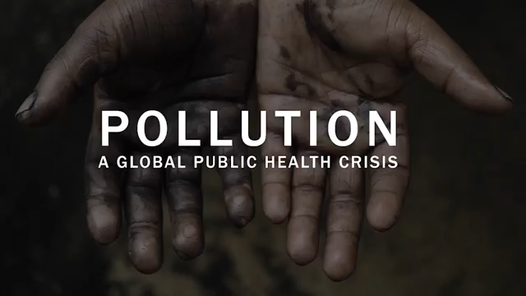
Pollution’s Effect on Health
While parts of the US (including Chicago) have air pollution levels that violate WHO standards, the vast majority of the burden of air pollution and other pollution occurs in the developing world
This video is from the Lancet Commission on Pollution and Health.

Slide 28
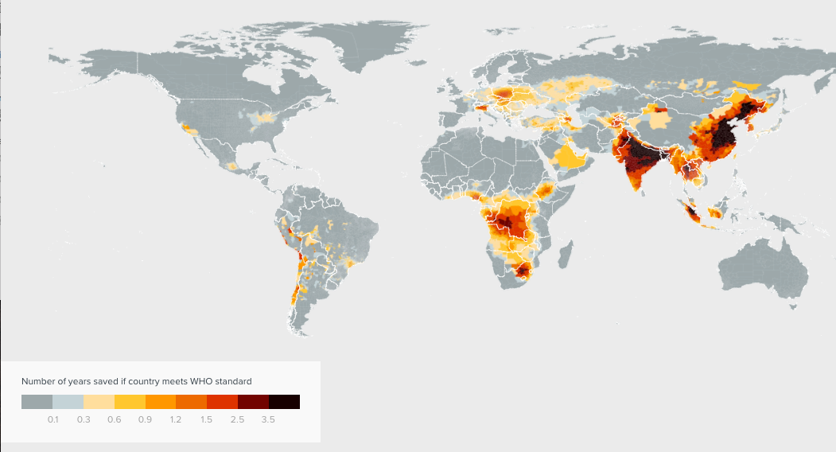
PM Life Years Map
Loss of Life Expectancy Due to PM_{2.5} Levels Exceeding WHO Standard
<used to direct attention toward China and India in particular>

Slide 29
Introduction to local pollution
Why does air pollution matter?
Willingness to Pay for Environmental Quality
Theory of WTP
Estimation of WTP
Research Methods for Health & Pollution
Value of a Statistical Life
Pollution & Policymaking

Slide 30

Willingness to pay (WTP)
The maximum amount of money that a person can and wants to exchange to consume a good or avoid a certain outcome, while holding utility constant.
For pollution, an individual’s WTP is a function of
Health impacts of pollution
Impacts on income
Aesthetics
Income
Assumes that the utility function is a function of environmental quality, both directly (via aesthetics) and indirectly (via health)

Slide 31
Introduction to local pollution
Why does air pollution matter?
Willingness to Pay for Environmental Quality
Theory of WTP
Estimation of WTP
Research Methods for Health & Pollution
Value of a Statistical Life
Pollution & Policymaking

Slide 32
Deriving WTP - Introduction
Let us assume that there are two goods:
environmental quality
composite good (i.e. everything the consumer would otherwise want)
We normalize the unit of the composite good to be the amount that can be purchased with $1.
$ money available for composite good
Units of environ. quality

Slide 33
Indifference Curves
Let us assume that there are two goods:
environmental quality
composite good (i.e. everything the consumer would otherwise want)
We normalize the unit of the composite good to be the amount that can be purchased with $1.
To the left is an indifference curve (IC). Given any two points on each IC, the consumer is equally happy/satisfied at each point. In technical terms, utility is constant on any IC.
$ money available for composite good
Units of environ. quality

Slide 34
Indifference Curves
For each good, consumers receive higher utility with greater consumption.
Utility increases towards the upper right of the graph
For any point A₂ on the indifference curve IC₂, the consumer has higher utility (more happiness/satisfaction) than any point A₁ on the indifference curve IC₁.
$ money available for composite good
A₂
IC₂
A₁
IC₁
Units of environ. quality

Slide 35
Deriving Marginal WTP
Let us choose a particular point A on the given indifference curve IC.
$ money available for composite good
A
IC
Units of environ. quality

Slide 36
Deriving Marginal WTP
Let us choose a particular point A on the given indifference curve IC.
The slope of the tangent line at A tells us how much money (spent on the composite good) the consumer would be willing to exchange for an additional unit of environmental quality.
$ money available for composite good
A
IC
Units of environ. quality

Slide 37
Deriving Marginal WTP
The slope of the tangent line at A tells us how much money the consumer would be willing to exchange for an additional unit of environmental quality.
If the green line has slope -0.5, then the consumer is willing to give up $0.50 of spending on the composite good to pay for an additional unit of environmental quality
The marginal willingness to pay (MWTP) at A is the absolute value of the slope of IC at A. (when environmental quality is on the x-axis and composite good is on the y-axis.)
$ money available for composite good
A
IC
Units of environ. quality

Slide 38
Deriving Marginal WTP
The marginal willingness to pay differs along the indifference curve.
Generally, we assume that the marginal willingness to pay for environmental quality (or any other good) decreases the more we consume
If the consumer consumes bundle B, with only B_{e} units of environmental quality and slope -2, then the MWTP for another unit of environmental quality is $2
If the consumer consumes bundle A, with A_{e} units of environmental quality and slope -0.2, then the MWTP for another unit of environmental quality is $0.20
$ money available for composite good
B
A
B_{e}
A_{e}
Units of environ. quality

Slide 39
Deriving Non-Marginal WTP
Willingness to pay for a non-marginal change ΔX is given by the bracketed amount ΔY.
$ money available for composite good
B
B_{c}
ΔY
A
A_{c}
B_{e}
A_{e}
Units of environ. quality
ΔX

Slide 40
Introduction to local pollution
Why does air pollution matter?
Willingness to Pay for Environmental Quality
Theory of WTP
Estimation of WTP
Research Methods for Health & Pollution
Value of a Statistical Life
Pollution & Policymaking

Slide 41
In practice…
It is challenging to measure WTP for environmental quality, because there generally aren’t explicit markets for these goods. Stores don’t sell clean air so the usual approach of measuring quantities and prices is not available.
Economists have developed several techniques to estimate WTP, even without explicit markets for environmental quality. Two of the most frequently used approaches are:
Hedonics
Use housing markets to uncover an estimate of WTP that, in principle, captures the full valuation
Health Production Function Approach (Valuation by Parts)
Use model to derive the components of WTP, then estimate the components
But why don’t we just ask people directly for their valuations?

Slide 42
Contingent Valuation
Contingent valuations are conditional on the existence of hypothetical counterfactual situations or markets
Often implemented via surveys
No actual money at stake
Estimates from contingent valuation tend to be unreliable…

Slide 43
Problems with Contingent Valuation
Diamond & Hausman (JEP, 1994) list a set of issues with contingent valuation surveys:
Credibility – are respondents answering the question the interviewer wants to ask?
Reliability – not putting your money where your mouth is
Precision – variability in responses
Empirical evidence suggests that stated WTP from contingent valuations is inconsistent with economic theory, as well as with revealed preferences
Embedding effect – survey respondents do not form individual preferences about quantities of public goods in an abstract framework
e.g. WTP tends to be the same whether 1 lake or 5 lakes are cleaned
Diamond & Hausman conclude that contingent valuation surveys inherently cannot measure the preferences they seek to measure, regardless of survey methods

Slide 44
Introduction to local pollution
Why does air pollution matter?
Willingness to Pay for Environmental Quality
Theory of WTP
Estimation of WTP
Hedonic Method – Comprehensive
Health Production Function – By Parts
Research Methods for Health & Pollution
Value of a Statistical Life
Pollution & Policymaking

Slide 45
Introduction to Hedonic Regression
Consider the price of a house as a function of all of the house’s characteristics and each of these characteristics has a price attached to it:
Square footage, # bedrooms, # bathrooms, neighborhood school quality, local environmental quality, etc.
If we could control for all the other attributes, but have exogenous variation in local environmental quality, then we could uncover how much people would be willing to pay for a reduction of X units of particulate pollution
e.g. compare the prices of homes in places with 50 μg/m³ and 100 μg/m³ PM2.5 concentrations, given all other attributes held equal

Slide 46
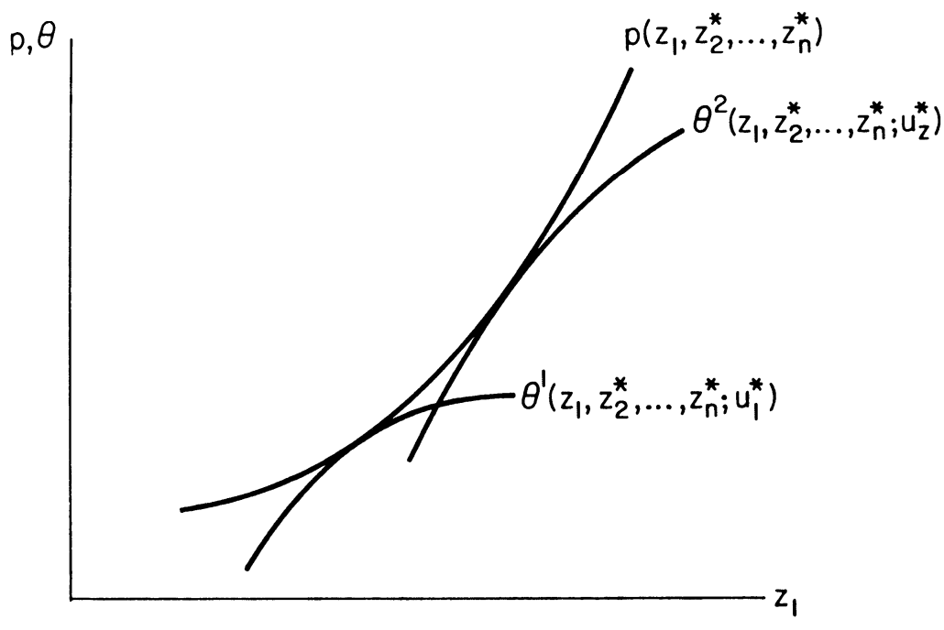
Rosen – “Hedonic Prices and Implicit Markets” (1974)
Consider a house as a vector of attributes (z₁, z₂, … z_{n}). Let z₁ denote environmental quality. Suppose we can hold all the other attributes constant – this is what the asterisks indicate.
Let p be the market price of a house.
First consider the demand side: Here, ϴ¹ and ϴ² are bid curves – how much consumer 1 and 2 are willing to pay for a house with environmental quality z₁.

Slide 47
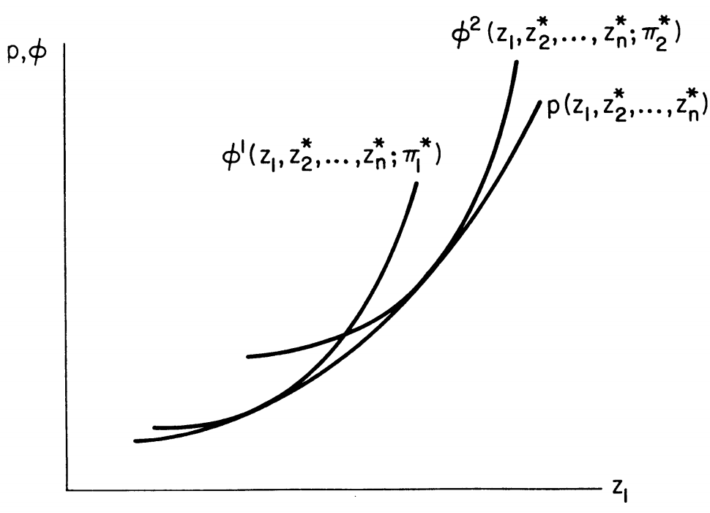
Rosen – “Hedonic Prices and Implicit Markets” (1974)
Consider a house as a vector of attributes (z₁, z₂, … z_{n}). Let z₁ denote environmental quality. Suppose we can hold all the other attributes constant – this is what the asterisks indicate.
Let p be the market price of a house.
Now consider the supply side: ɸ¹ and ɸ² are offer curves – how much suppliers 1 and 2 must receive to build a house with environmental quality z₁.

Slide 48
Equilibrium in the Hedonic Model
The points of tangency between consumer bid curves and supplier offer curves form a locus of equilibria that we call the hedonic price schedule.
The slope of the hedonic price schedule is the MWTP!

Slide 49
Application of Hedonic Method: Chay & Greenstone (JPE, 2005)
Introduction
The 1970 Clean Air Act designated counties as “attainment” or “non-attainment”
”Non-attainment” counties had stricter emissions controls, plant-specific regulations for each major source of pollution
Non-attainment counties had 10 mg/m³ greater decline in TSPs, and 2.5% greater rise in house prices

Slide 50
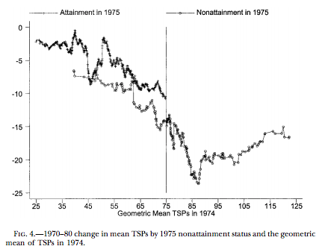
Chay & Greenstone (JPE, 2005)
Method
Paper finds that nonattainment counties had a 5 μg/m³ larger decline in TSP concentrations, relative to attainment counties, between 1970 and 1980.

Slide 51
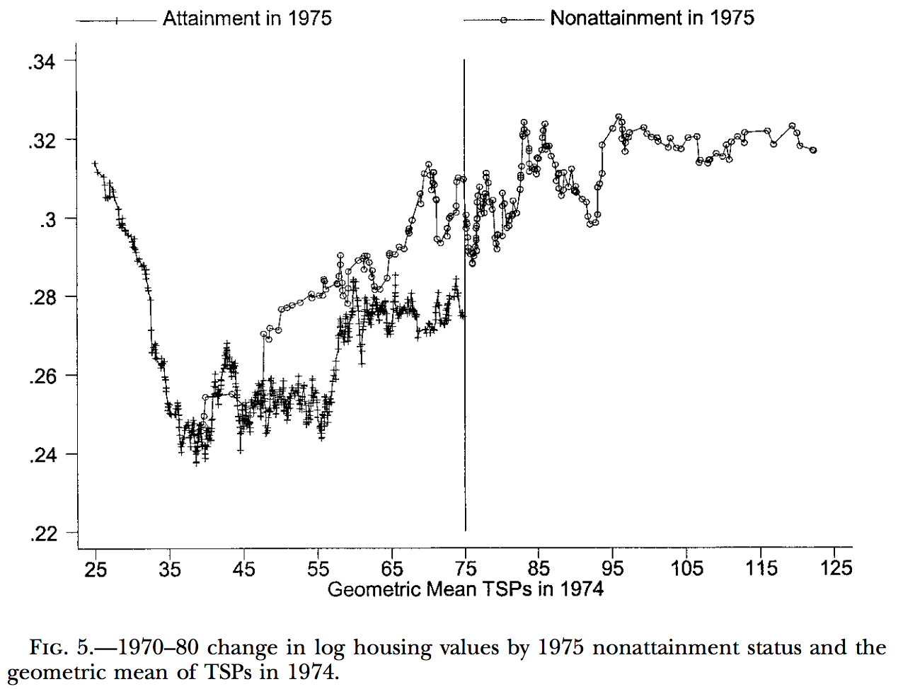
Chay & Greenstone (JPE, 2005)
Method
Paper finds that nonattainment counties had a 2.5% larger increase in housing prices, relative to attainment counties, between 1970 and 1980.

Slide 52
Chay & Greenstone (JPE, 2005)
Results
Authors uncovered marginal WTP estimate of 0.20% to 0.35% increase in house prices for a 1% decline in TSP concentrations
WTP for late 1970s reductions in TSPs in non-attainment counties was $63 billion in 2001 dollars

Slide 53
Introduction to local pollution
Why does air pollution matter?
Willingness to Pay for Environmental Quality
Theory of WTP
Estimation of WTP
Hedonic Method – Comprehensive
Health Production Function – By Parts
Research Methods for Health & Pollution
Value of a Statistical Life
Pollution & Policymaking

Slide 54
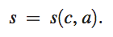
Deriving WTP – Separation into Components
Review: MWTP equals the absolute value of the slope of the indifference curve
But we can also mathematically derive MWTP.
Suppose that sick days s depend on pollution dose d. The dose d in turn depends on pollution concentration c and defensive behavior a:
$ money for composite good
A
Units of environ. quality

Slide 55
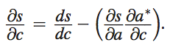
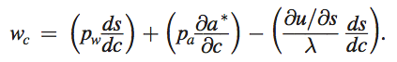
Deriving WTP – Separation into Components
The partial effect of ambient pollution on sick days is a sum of the total derivative and the indirect effect of defensive behavior:
-
+
Disutility of sickness (includes mortality)
The MWTP for clean air, w_{c}, is:
Income
Cost of defensive investments
Notes:
NB: I left out the specific form of the budget constraint because it does not aid in deriving MU_{e}, but does make things more complicated. As Kuperberg often told me: “keep it simple, stupid”

Slide 56
Application of Health Production Function: Defensive Investments
Deschenes, Greenstone, Shapiro (2017) examined the NO_{x} Budget Program (NBP), which reduced summer NO_{x} emissions and thereby ozone concentrations
People respond to air pollution by purchasing health investments (e.g. asthma inhalers) to protect themselves from the pollution
However, in the absence of air pollution, people would spend this money on other goods that provide them with more utility

Slide 57
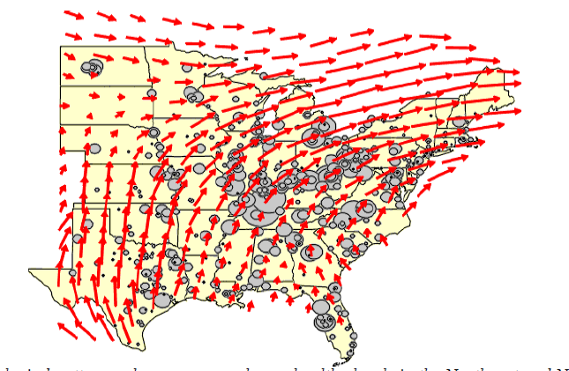
Deschenes, Greenstone, Shapiro (2017)
What was the NBP?
NO_{x} are inputs into ozone production
Solution to high ozone concentration issues on the East Coast, partly due to NO_{x} emissions in the Midwest
Caps in 19 states, all implemented via cap & trade
Only 17% chose expensive scrubbers
8 states in 2003, 11 states in 2004

Slide 58
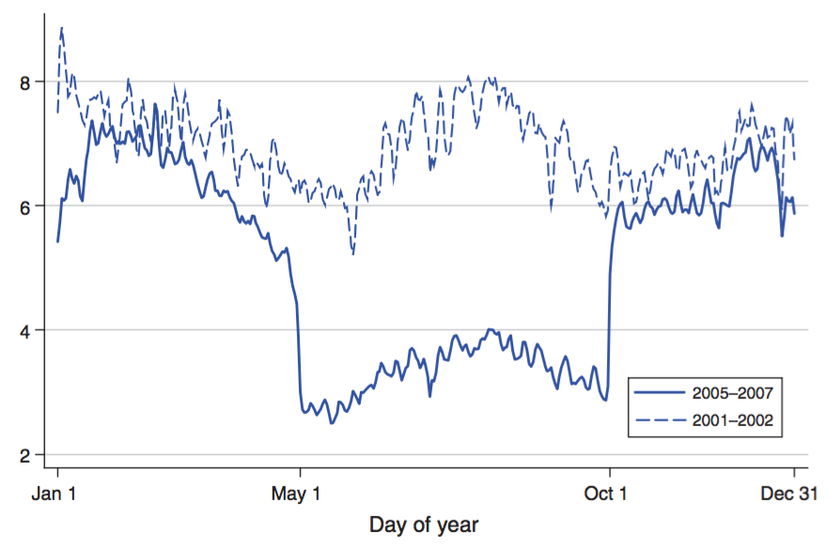
Deschenes, Greenstone, Shapiro (2017)
NBP operated from 2003 to 2008, only from May 1 to Sept 30, and reduced NO_{x} emissions by 40%

Slide 59
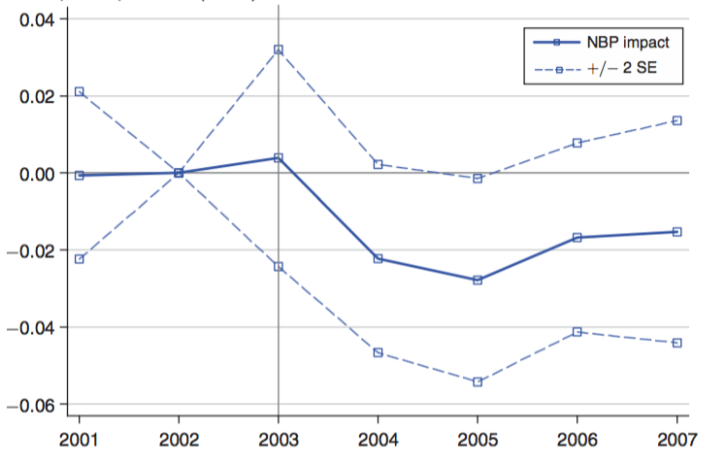
Deschenes, Greenstone, Shapiro (2017)
Resulted in 1.6% reduction in medication purchases for protection against harm
Savings of $800 million annually

Slide 60
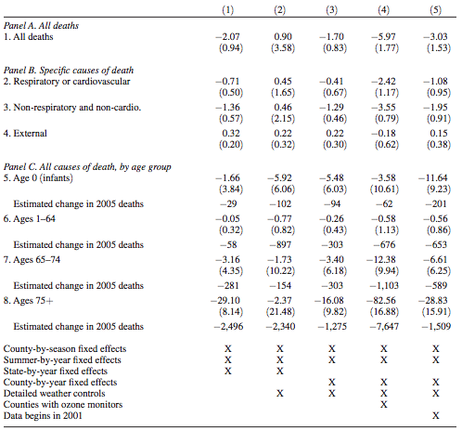
Deschenes, Greenstone, Shapiro (2017)
This table shows that mortality decreased due to the NBP
Effects seen for both cardiorespiratory and non-cardiorespiratory
Strongest effects seen in age 75+ group

Slide 61
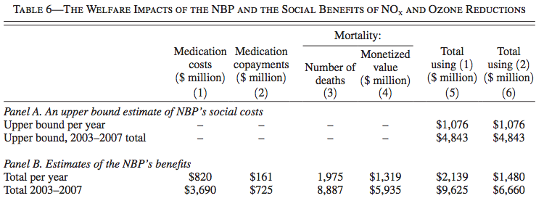
Deschenes, Greenstone, Shapiro (2017)
Here is a demonstration of the health production function’s components!

Slide 62
Introduction to local pollution
Why does air pollution matter?
Willingness to Pay for Environmental Quality
Theory of WTP
Estimation of WTP
Research Methods for Health & Pollution
Observational Studies
Quasi-Experiments
RCTs
Value of a Statistical Life
Pollution & Policymaking

Slide 63
Acute Exposure Measurements
Episode studies
Draw clear links between episodes of stagnant, polluted air and mortality and morbidity
Donora, PA and London, for example
Mortality counts
Observe trends in daily death counts and changes in particulate air pollution
Hospitalizations
Similar to mortality counts, but observes daily hospital admissions rather than mortality
Symptoms/Lung function
Associates daily respiratory symptoms and air pollution
Often follows people with asthma
Notes:
These studies challenged by very little daily monitoring of fine particles
Source: C. Arden Pope III “Epidemiology of Fine Particulate Air Pollution and Human Health: Biologic Mechanisms and Who’s at Risk?”

Slide 64
Chronic Exposure Measurements
Mortality rates
Compare annual mortality rates among populations that receive different amounts of pollution
Survival/Life expectancy
Evaluates mortality in cohorts of people from long-term pollution exposure
Harvard Six-Cities study is an example
Disease/Lung function
Evaluates long-term exposure and respiratory symptoms
Notes:
Chronic exposure allows us to answer questions about pollution effects on length of life, mortality, or chronic disease

Slide 65
Introduction to local pollution
Why does air pollution matter?
Willingness to Pay for Environmental Quality
Theory of WTP
Estimation of WTP
Research Methods for Health & Pollution
Observational Studies
Quasi-Experiments
RCTs
Value of a Statistical Life
Pollution & Policymaking

Slide 66
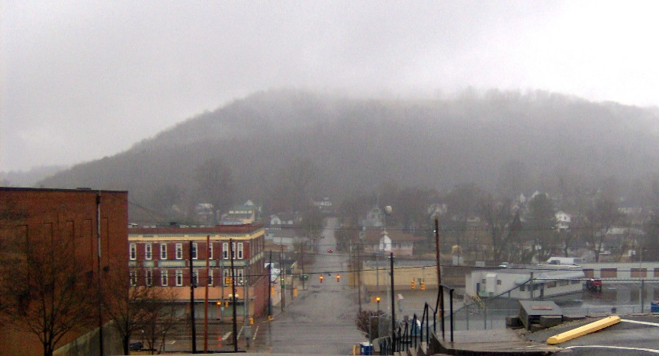

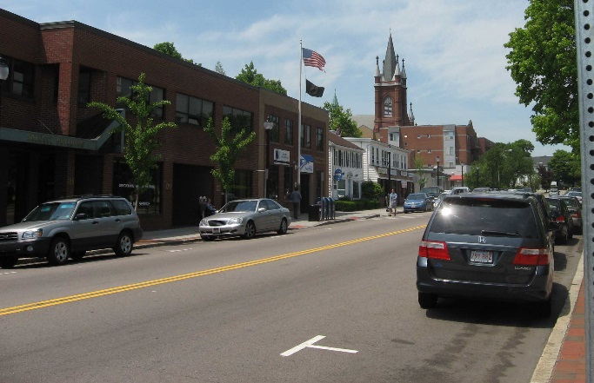
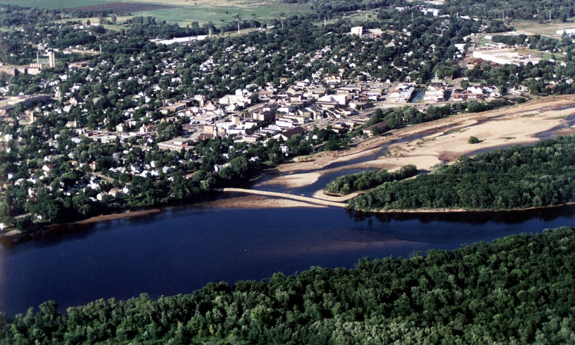
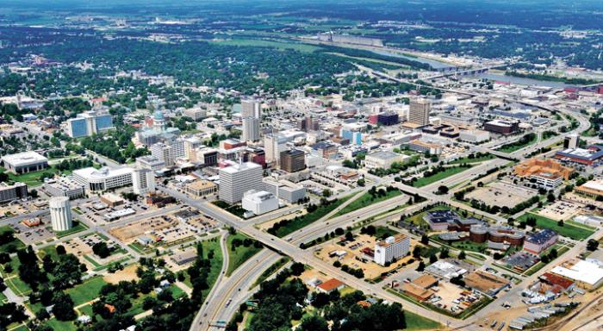
Canonical Example of Observational Approach: “Association between Air Pollution and Mortality in Six U.S. Cities”
Watertown, Massachusetts
Harriman, Tennessee
St. Louis, Missouri
Steubenville, Ohio
Portage, Wisconsin
Topeka, Kansas
Notes:
1993 study which randomly selected sample of 8111 white adults ages 25-74 from six places, final follow-up happened 14-16 years after study began depending on the person. Ambient concentrations of total suspended particulate matter, sulfur dioxide, ozone, and suspended sulfates measured in each place.
Demonstrated association between mortality risk and final particulate concentrations (PM2.5) and 2-3 year difference in life expectancy across cities.

Slide 67
Six Cities Study: Design
First long-term study on effects of low to moderate sustained PM exposure
Enrollment survey with questions about age, sex, weight, height, education level, complete smoking history, occupational exposures, and medical history
Annual informational letters and return postcards with a question on vital status mailed to subjects
Used multiple regression to control for correlations of individual risk factors
However, an observational study relies heavily on having the “right” set of controls available.

Slide 68
Six Cities Study: Pollution
Characteristic | Portage, Wis. | Topeka, Kans. | Watertown, Mass. | Harriman, Tenn. | St. Louis | Steubenville, Ohio
Fine particle concentration (μg/m³) | 11 | 13 | 15 | 21 | 19 | 30

Slide 69
Six Cities Study: Pollution & Controls
Characteristic | Portage, Wis. | Topeka, Kans. | Watertown, Mass. | Harriman, Tenn. | St. Louis | Steubenville, Ohio
Fine particle concentration (μg/m³) | 11 | 13 | 15 | 21 | 19 | 30
Smokers (%) | 36 | 33 | 40 | 37 | 35 | 35

Slide 70
Six Cities Study: Pollution & Controls
Characteristic | Portage, Wis. | Topeka, Kans. | Watertown, Mass. | Harriman, Tenn. | St. Louis | Steubenville, Ohio
Fine particle concentration (μg/m³) | 11 | 13 | 15 | 21 | 19 | 30
Smokers (%) | 36 | 33 | 40 | 37 | 35 | 35
Less than high-school education (%) | 25 | 12 | 22 | 35 | 45 | 30

Slide 71
Six Cities Study: Pollution & Controls
Characteristic | Portage, Wis. | Topeka, Kans. | Watertown, Mass. | Harriman, Tenn. | St. Louis | Steubenville, Ohio
Fine particle concentration (μg/m³) | 11 | 13 | 15 | 21 | 19 | 30
Smokers (%) | 36 | 33 | 40 | 37 | 35 | 35
Less than high-school education (%) | 25 | 12 | 22 | 35 | 45 | 30
Average body-mass index | 26.3 | 25.3 | 25.5 | 25.1 | 26.0 | 26.4

Slide 72
Six Cities Study: Pollution & Controls
Characteristic | Portage, Wis. | Topeka, Kans. | Watertown, Mass. | Harriman, Tenn. | St. Louis | Steubenville, Ohio
Fine particle concentration (μg/m³) | 11 | 13 | 15 | 21 | 19 | 30
Smokers (%) | 36 | 33 | 40 | 37 | 35 | 35
Less than high-school education (%) | 25 | 12 | 22 | 35 | 45 | 30
Average body-mass index | 26.3 | 25.3 | 25.5 | 25.1 | 26.0 | 26.4
Job exposure to dust or fumes (%) | 53 | 28 | 38 | 50 | 40 | 48

Slide 73
Six Cities Study: Results
Results:
Mortality rates most strongly associated with smoking
Significant and robust association between air pollution and mortality
Adjusted mortality-rate ratio for most polluted cities compared with least polluted was 1.26
However, there are lots of differences between the populations and there appears to be a great risk of confounding
This was a very important study but since its publication researchers have looked for more compelling research designs to determine causal impacts…

Slide 74
Introduction to local pollution
Why does air pollution matter?
Willingness to Pay for Environmental Quality
Theory of WTP
Estimation of WTP
Research Methods for Health & Pollution
Observational Studies
Quasi-Experiments
RCTs
Value of a Statistical Life
Pollution & Policymaking

Slide 75
Quasi-Experimental Methods
Observational studies have their limitations:
Differing initial levels of health in population of polluted areas
Other health determinants correlated with air pollution (water pollution, hospital quality)
Many determinants of health are unobserved
But we often can’t run randomized control trials.
What is a quasi-experiment?
Treatment and control groups can exist even when researchers don’t set them up
Politics, accidents, or changes in regulation create “treatments”
Similar populations that received different treatments can be compared
Offers the potential eliminates confounding and omitted variable bias and produce causal estimates
Notes:
We will see example of this later when we look at Huai river paper

Slide 76
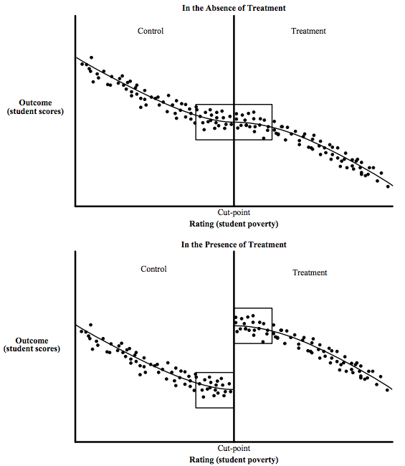
Quasi-Experimental Methods
Regression Discontinuity
Many real-world policies have a cutoff threshold that induces a discontinuity at the cutoff
A counterfactual world without the cutoff should have no discontinuity
Compare the subjects around the cutoff, below vs. above, to determine the treatment effect
Observations around the cutoff should be similar on key characteristics
Example: A policy that boosts funding for school districts with poverty rates above the cutoff level

Slide 77
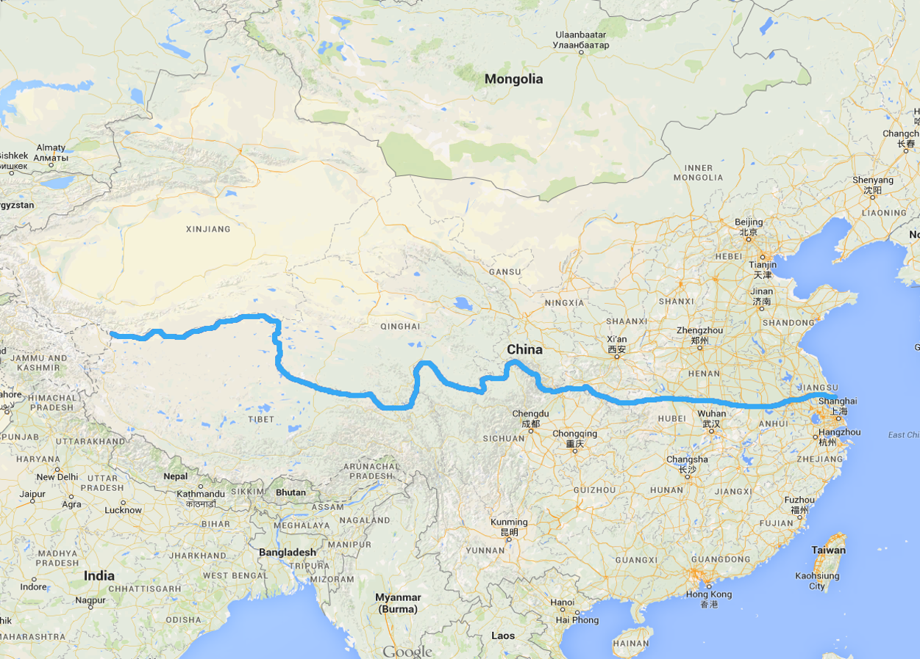
Practical Example: China’s Huai River Coal Policy (Regression Discontinuity)
Studied impacts of particulate matter in a setting with long-term sustained levels of pollution
Chinese migration historically very limited and controlled
Quasi-experiment using regression discontinuity at the Huai River
Ebenstein, Fan, Greenstone, He, Zhou (PNAS, 2017)
Notes:
Discuss the significance of the Huai River as a natural division between northern and southern China, including the climate on either side.

Slide 78
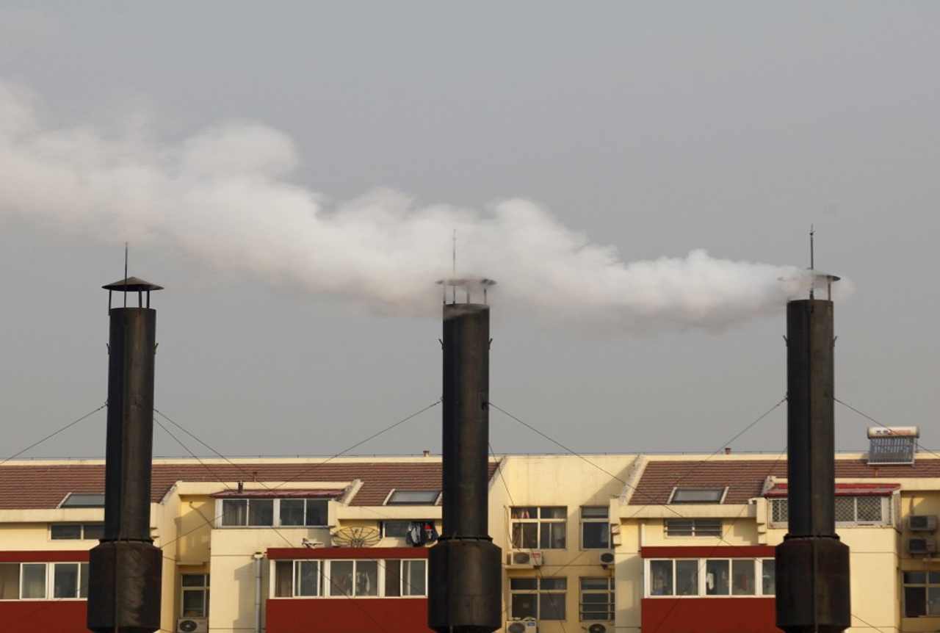
The Boiler Heating System
Subsidized coal is burned to heat water, often in a boiler housed in a building. The combusted coal emits high levels of soot and particulate matter.

Slide 79
PM10 Concentrations, by distance from river

Slide 80
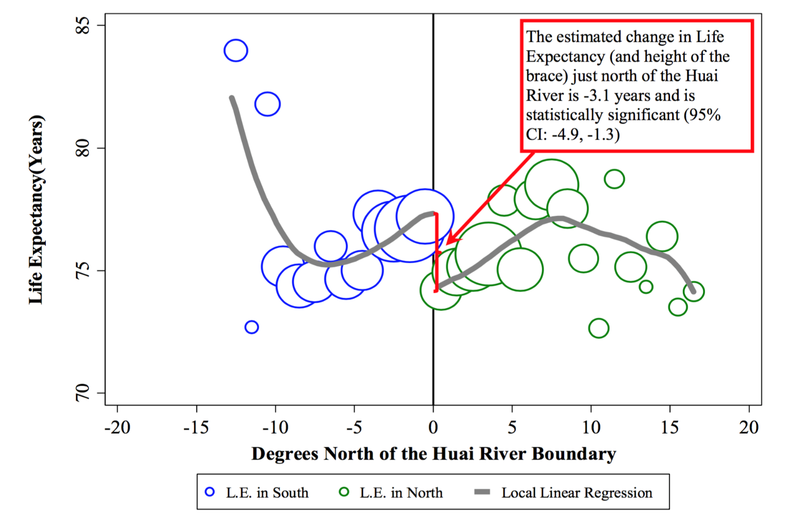
Life expectancy, by distance from river
Notes:
Perhaps add that a hedonic regression might actually show that the increased comfort and economic value from subsidized winter coal offsets the greater pollution and mortality cost.

Slide 81
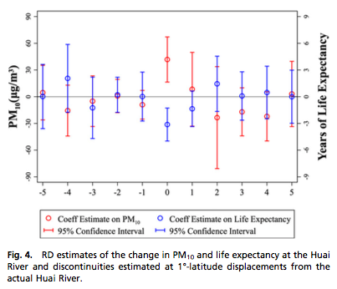
Robustness Check: “Fake Huai”
To show that the RD design is robust, it is important to ensure that there are no spurious discontinuities at other cutoffs.
Here, in the graph, you can see a clear RD difference at 0 (the latitude of the Huai River), but insignificant differences at the other latitudes.

Slide 82
Results
3.1 life years lost, per person, north of the Huai River vs. south
Each 10 μg/m³ increase in PM10 concentrations reduces life expectancy at birth by 0.64 years
Bringing all of China into compliance with Chinese Class I standards (which are more lenient than WHO standards) would save 3.7 billion life years
Entire effect comes from cardiorespiratory causes of death, no impact of PM10 for other causes
Effect evident throughout the life-cycle due to continuous exposure
Notes:
3

Slide 83
Introduction to local pollution
Why does air pollution matter?
Willingness to Pay for Environmental Quality
Theory of WTP
Estimation of WTP
Research Methods for Health & Pollution
Observational Studies
Quasi-Experiments
RCTs
Value of a Statistical Life
Pollution & Policymaking

Slide 84
The gold standard – Randomized Control Trial (RCT)
Randomized Control Trial
Experimental method of testing the impact of a treatment on a population
Extensively used in medicine and the hard sciences
Over the past decade, has caught on in many field subfields of economics
Gwenyth Paltrow starred in the 1998 movie “Sliding Doors.” After being fired from her job, she misses the subway on her way home. But in another reality, she makes the subway. The movie depicts both realities.

Slide 85
The gold standard - RCT
Motivation:
Controlled experiment in any science compares the impact of a treatment on identical treatment and control groups
In real life, can’t compare the same people under two alternate realities
Gwenyth Paltrow starred in the 1998 movie “Sliding Doors.” After being fired from her job, she misses the subway on her way home. But in another reality, she makes the subway. The movie depicts both realities.

Slide 86

What is an RCT?
Choose groups randomly
This guarantees that the samples are statistically identical

Slide 87

Example RCT: Experiment to improve indoor air pollution
The Problem:
Over 70% of households and 90% of rural households use solid fuels
Resulting toxic pollutants cause increased risk of lung cancer, and cardiovascular and respiratory disease
Survey of 2,400 households in rural Odisha, India found one-third of adults and one-half of children in survey experienced symptoms of respiratory illness around time of survey
Martin et al. (2011) claim that indoor air pollution contributes to nearly 2 million deaths annually
Notes:
Source: JPAL summary of “Cooking Stoves, Indoor Air Pollution, and Respiratory Health in India”

Slide 88
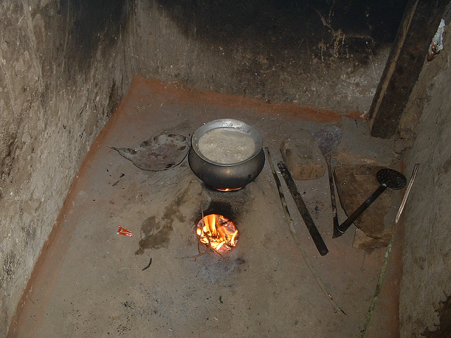
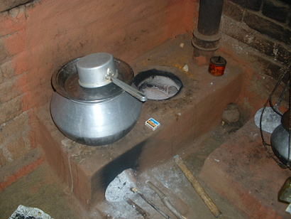
Experimenting to improve indoor air pollution
Hanna, Duflo, and Greenstone (2016). “Up in Smoke: The Long-Run Impact of Improved Cooking Stoves in the Presence of Household Behavior”
Left: A typical stove made of mud, resulting in blackened walls!
Right: Improved “Chulha” stove designed to contain smoke

Slide 89
Experimental design
Randomized timing of improved stove construction among 2500 households
1/3 constructed upfront, 1/3 halfway through, 1/3 at the end
Before-and-after differences uncovers the effects and take-up rate of stoves
Households in each group are indeed similar
Tracked households for up to 4 years after intervention

Slide 90
Findings: take-up
Differential take-up falls from 65% (Yr 1) to 44% (Yr 3)
Differential existence of good condition stove is relatively low: about 40% at start, and falls to about 30% (not pictured)
Lottery 2 and Stove Rebuilding

Slide 91
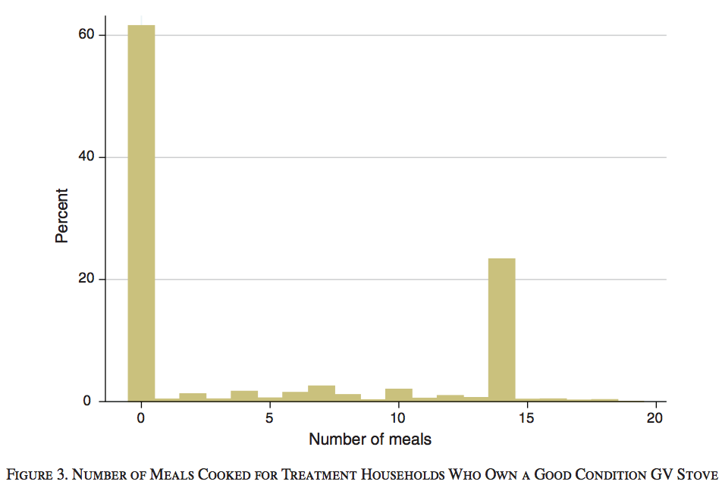
Findings
Using and maintaining the improved stove is costly
Share of households that maintained stoves in good condition was 36 pp in treatment households
Initial decrease in smoke inhalation in year 1, but effect disappears by year 2

Slide 92
Findings: health effects and other effects
Limited effect of treatment (improved stove intervention) on CO concentrations in respondents’ breaths
Slight but statistically insignificant decrease of 0.23 ppm (3.1%) for primary cooks. Effects are also negative but but statistically insignificant for children.
Effect decreases over time
Stoves can be effective at reducing exposure to indoor pollution, but only as long as they are used properly
No effect on lung functioning nor on the other 29 health estimates
No effect on fuel use or time spent cooking
Households using improved stoves made more repairs than those using traditional stoves

Slide 93
Introduction to local pollution
Why does air pollution matter?
Willingness to Pay for Environmental Quality
Theory of WTP
Estimation of WTP
Research Methods for Health & Pollution
Value of a Statistical Life
Pollution & Policymaking

Slide 94
Value of a Statistical Life (VSL)
The health production function relies on an estimate of MWTP to avoid mortality. But how do we place a monetary value on lives saved by a cleaner environment?
It is tempting to make this value infinite, but then the MWTP would be infinite.
Would you be willing to give up all your money for a minuscule reduction in the risk of your death?
People make plenty of decisions that trade off a (positive/negative) amount of money for a (decrease/increase) in mortality risk, suggesting a finite VSL.
VSL is used in the areas of medicine, environment, and transportation safety.
VSL is the willingness to trade changes in wealth for marginal changes in the probability of death
VSL is NOT a measure of the value of a life

Slide 95
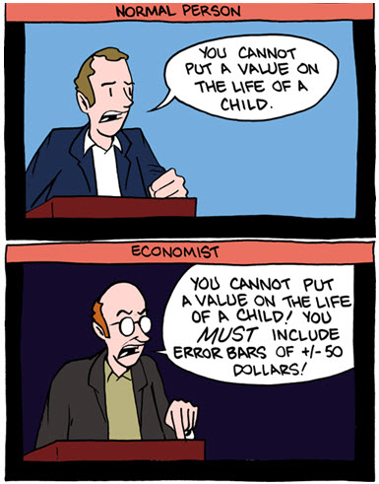
VSL in the public eye
In 2008 the EPA reduced its VSL estimate. America had lots to say…
“EPA may not think Americans are worth all that much, but the rest of us believe the value of an American life to our families, our communities, our workplaces and our nation is no less than it has ever been”
–Barbara Boxer, Senate Environment Committee Chairwoman
“The ultimate capitalist perversion. Putting a monetary value on human life. We have truly crossed over into hell on earth when we can seriously discuss how much money a life a life is worth…” -anonymous
“Someplace else, people might tell you that human life is priceless. In Washington, the federal government has appraised it like a ‘96 Camaro with bad brakes…” -anonymous
Notes:
Comments compiled in a pdf titled “One hundred reasons why we should replace the ‘Value of a Statistical Life’ with ‘Willingness to Pay for a Microrisk Reduction’” by UofO economist Trudy Ann Cameron

Slide 96
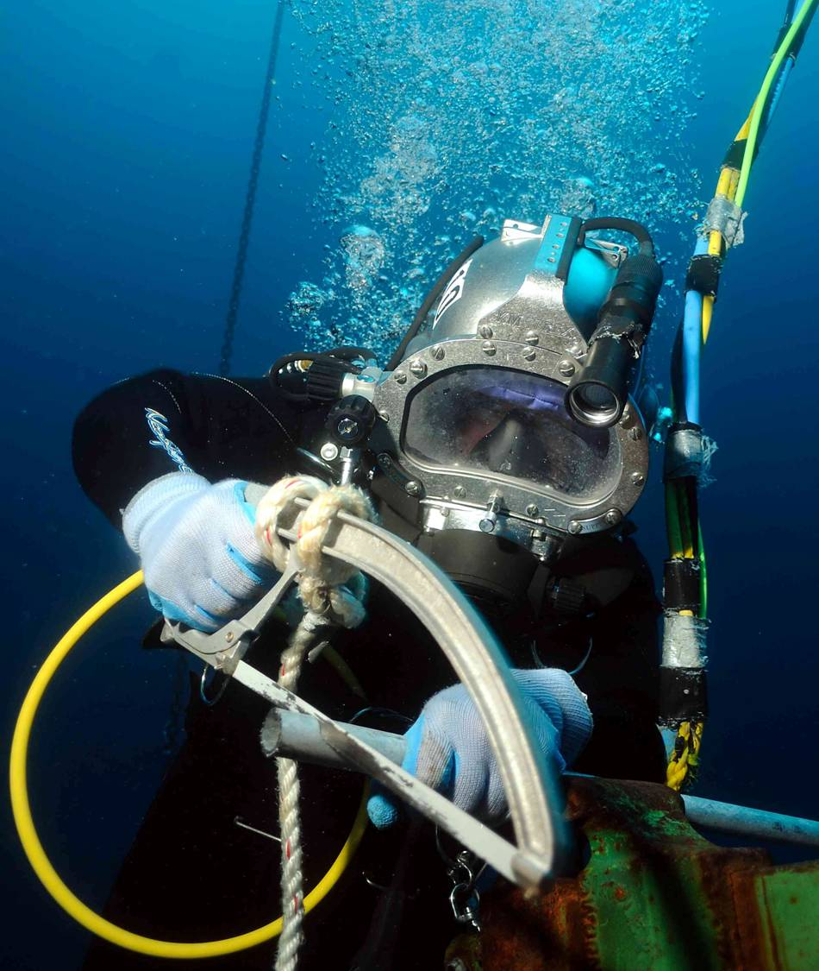
Calculating VSL
Method:
Must be measured indirectly by observing behavior in risky situations
What is the rate at which an individual will trade wealth for an increased probability of harm?
As before, you could simply ask people hypothetical questions directly
Or you could employ revealed preferences, e.g.:
Compare wage differences among jobs of various risk
Look at non-labor risky decisions such as speed limit increases
Commercial Diving: a high-risk, high-paying job
Notes:
How much money would you have to be given to increase your probability of death by some amount? This should depend on how much the probability will change, and what probability you are already at.
“Revealed preferences” gets its name from the fact that human choices imply, or reveal, how much things are worth, in this case how much safety and thereby life is worth.
Elaborate on speeding example using 2004 “Using Mandated Speed Limits…” if time

Slide 97
Using U.S. Army Reenlistment Decisions to Estimate the VSL (Greenberg, Greenstone, Ryan, Yankovich 2017)
Exploiting reenlistment decisions of over 500,000 soldiers in the U.S. Army from 2002 – 2010
2 main determinants of reenlistment rates:
Mortality: mean of 4.5 per 1,000 over 4 year enlistment in sample
Selective Reenlistment Bonuses: mean bonuses ranged from $5,546 (2010) to $14,861 (2006)
Model decision to reenlist as a function of the bonus, occupation-specific fatality rates, and soldier observable characteristics
Reenlistment is highly responsive to bonuses and to mortality rates
Notes:
Used this

Slide 98
Greenberg, Greenstone, Ryan, Yankovich (2017)
Results
The response variable is the log odds of reenlistment
“Bonus offer” shows that an additional $1000 bonus increases re-enlistment by 2.3% to 2.5%
Mortality hazard shows that an increase in the fatality rate by 1 per 1,000 leads to a reduction in the reenlistment rate of 1.1% to 1.4%.
Notes:
From Table 7: Multinomial and Nested Logic Results
Jan 2017 draft of VSL paper.

Slide 99
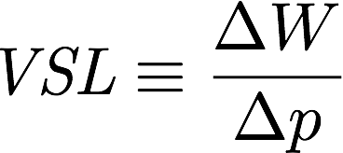
Reenlistment VSL
VSL is willingness to trade changes in wealth (W) for marginal changes in the probability of death (p)
Allow the effects of the bonus and the expected mortality rate to vary with the levels of wealth and probability of death
Allows for marginal willingness to pay functions so that VSL is not a single number
Notes:
Not sure about the $500,000 number, this was written by Mike Galperin several months ago.

Slide 100
Greenberg, Greenstone, Ryan, Yankovich (2017)
Here are the reenlistment VSL results in a table
Subset of Army | VSL | VSI 95% Confidence Interval ($ thousands)
Full Sample | $517,000 | ($221, $813)
Men, Combat | $430,000 | (-$69, $929)
Men, Non-Combat | $642,000 | (-$87, $1,371)
Women, All | $1,354,000 | ($504, $2,204)
Notes:
From Table 7: Multinomial and Nested Logic Results
Jan 2017 draft of VSL paper.

Slide 101
Reenlistment VSL

Slide 102
Introduction to local pollution
Why does air pollution matter?
Willingness to Pay for Environmental Quality
Pollution & Policymaking
Clean Air Act

Slide 103
Clean Air Act of 1970: Motivation
In July 1969, TIME Magazine published a piece on the Cuyahoga River catching on fire for the 13th time.
TIME used this now-famous picture of a fire on the Cuyahoga from 1952. No actual pictures of the much smaller 1969 fire exist.
Notes:
https://clevelandhistorical.org/items/show/63

Slide 104
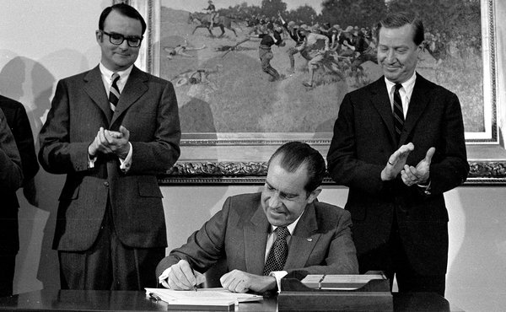
Clean Air Act of 1970: Politics
Approaching the 1972 election, President Nixon anticipated running against Edward Muskie, strategizing accordingly
February 1970: Nixon presented 23 legislative proposals to Congress, including amendments to air pollution laws
June: House passes a bill aligned with Nixon’s proposals
September: Muskie returns with more stringent bill that passed in the Senate, 73-0
December 18: Congress reconciles the two versions to become the 1970 Clean Air Act (signing picture at right)

Slide 105
Clean Air Act of 1970: Provisions
Transition from state, county, and municipality level regulation to federal regulation
Established National Ambient Air Quality Standards for 6 “criteria pollutants”: particulate matter, ozone, sulfur dioxide, nitrogen dioxide, carbon monoxide, and lead
States must create and adopt plans to achieve these standards
EPA responsible for updating standards and enforcement
Notes:
Note to MG: I couldn’t find any historical promotional materials from the EPA itself (as opposed to environmental NGOs) regarding the Clean Air Act

Slide 106
Clean Air Act of 1970: Outcomes
The costs were not insignificant though as EPA-designated “non-attainment counties” experienced reductions in economic activity
Non-attainment counties lost 590k jobs and $75 billion (1987 dollars) of output in polluting industries between 1972 and 1987 (Greenstone 2002)
Notes:
Is it worth mentioning the complication of many counties designated as nonattainment actually had pollution levels below the standards? Yes, I think so.
All pollution numbers exclude the contribution of wildfires.
Source: EPA
https://www.epa.gov/air-emissions-inventories/air-pollutant-emissions-trends-data

Slide 107
Clean Air Act of 1970: Outcomes
The largest life expectancy gains from the Clean Air Act were in small, industrial towns and cities.

Slide 108
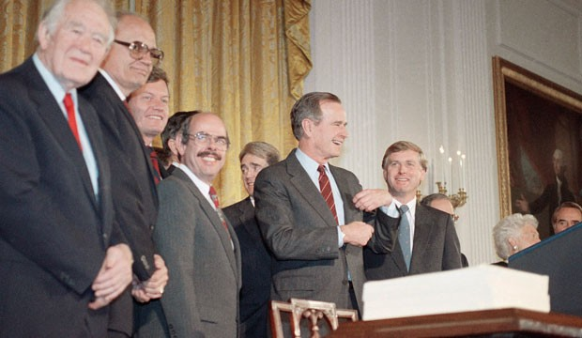
1990 CAA Amendments
Broadly, these amendments introduced a wider variety of policies, including performance-based standards and cap and trade
Set deadlines for attainment of standards, allowing most nonattainment regions 6 years to meet standards
Introduces market approach to curbing sulfur dioxide emissions to address acid rain
Tightens pollution standards for automobile emissions and introduces pilot program in California for low-emissions automobile manufacture and sale
President Bush after signing 1990 CAA

Slide 109
Main takeaways
Many forms of energy consumption and production involve the release of pollution that is harmful to human well-being.
Air pollution due to energy consumption has been a major source of concern since the 12th century AD and remains an especially great risk to human well-being in today’s developing countries.
Economists have developed a variety of theoretical and empirical methods to determine people’s willingness to pay for environmental quality. The application of these methods suggest that people around the world are willing to devote substantial resources for environmental quality.
US has a long track record of success at reducing pollution. Overall, it appears that benefits have been larger than costs, possibly substantially so.

